Slide 1
Need to make this functional and good looking. Do not just copy cells in excel do a proper layout please

Slide 2
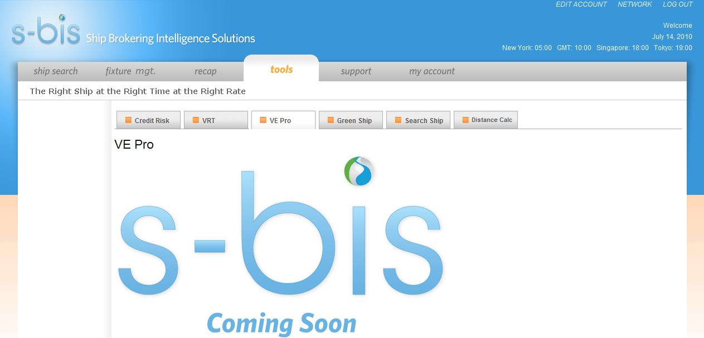
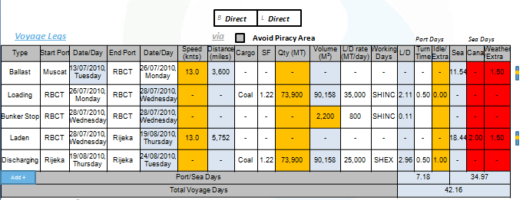
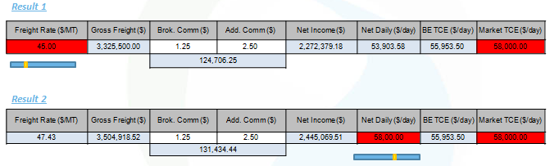
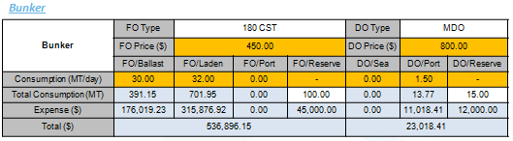
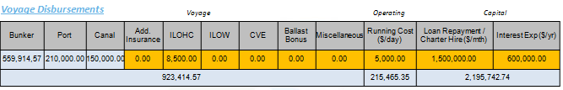
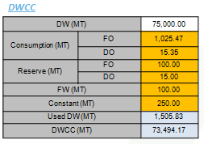
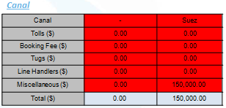
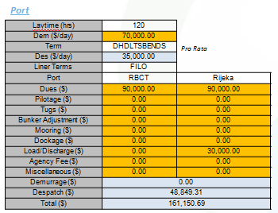
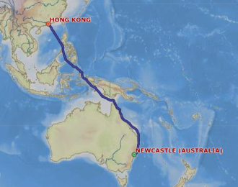
Calculations
Summary
Distance Tables
Piracy
Ports Intelligence
Bunker Pricing
Weather
New Scenario
Scenario Name | WCI 30-50 DWT 11-11 to 15-11
Vessel Name or IMO # | S CHINA | Click here for full specs
IMO | 9118795 | LOA | 100.72 m | Grain | 14442 | Class Notation | (+)A1, BULK CARRIER, (E), (+)AMS, (+)ACCU, SH SERVICE RESTRICTION: UNRESTRICTED SERVICE
Summer DWT | 8142 tons | Draft | 7.93 m | Grabs |  | Bulkheads | 4
Gross Tonnage | 6364 tons | Speed | 12.60 kn | Cargo Handling | GEARLESS
Built Year | 1995 | Breadth | 18.60 m | Decks Number | 2
Flag |  | Cranes | 1DERRICK X 30 t , 2 X 25 t | Lifting Equipment
http://map.openseamap.org/map/weather.php
WCI 30-50 DWT 11-11 to 15-11
Route Map
Save
Notes:
Each saved estimation will be categorized according to the ref no.
eg. WCI 30-50 DWT 11-11 to 15-11

Slide 3
Weather
Click on link to get map. We need to hide the URL etc
http://map.openseamap.org/map/weather.php
Calculations
Summary
Distance Tables
Piracy
Ports Intelligence
Bunker Pricing
Weather

Slide 4
Scenario
Amended
MV Sentosa Beaufort – GLESS SDBC
75,000 DWT, 13.86 SSDFT
Panama Flag, ABS, Built 2005
7 HO/WHA; 87,000/85,000 m³ Grain/Bale
Constant/FW: 250/100 MT
ROB (FO/DO): 500/100 MT
Reserve (FO/DO): 100/15 MT
IFO/MDO: USD 450/800 per MT
13 knots, (30/32) 180CST, 1.5 MDO port.
Current Location: Muscat
Load Port: RBCT 1sb, 35,000 SHINC, 12hr TT
Discharge Port: Rijeka 1sb; 25,000 SHEX, 12hr TT
Cargo: Coal (SF 1.22), Full Load
Laycan: 26th July 2010, Monday – 31th July 2010, Saturday
Demurrage: USD 70,000, DHDLTSBENDS
Brok/Add Comm.: 1.25/2.5 %
Freight: FILO

